Slide 1

Tech Conferences 2019-2022 Nigel Tart
Encourage you to go to conferences
ML with a laughably small dataset
Explain machine learning to non data scientists

Slide 2



Slide 3
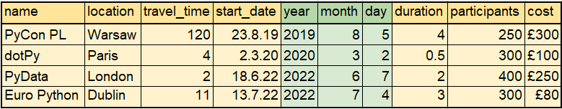
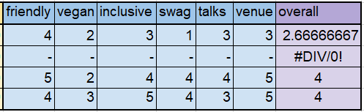
The Dataset

Slide 4
Predicting Paris, using Machine Learning
Split the data
2/3 training set
1/3 test set
Check accuracy
Make predictions and understand limits

Slide 5
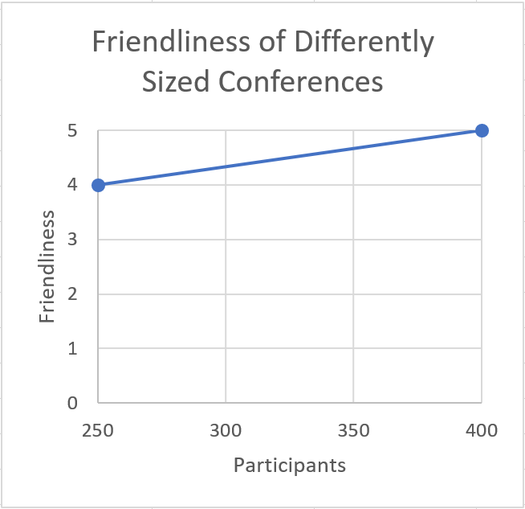
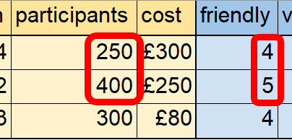
Linear Regression
Plot your data
Line of best fit
Prediction

Slide 6
Interpolation vs Extrapolation
inter-pol-ation
extra-pol-ation
within
limits
beyond
limits

Slide 7
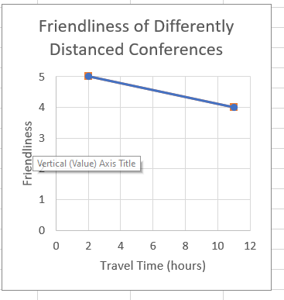

Linear Regression – Extrapolation
Plot your data
Line of best fit
Prediction

Slide 8
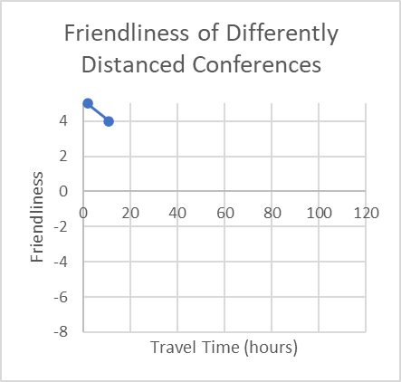
Linear Regression – Extrapolation
Plot your data
Line of best fit
Prediction

Slide 9
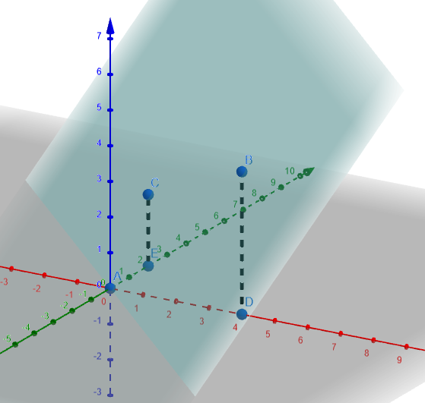
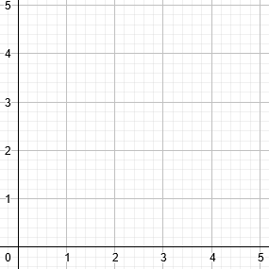
Scattergraphs in 3D – plane of best fit
z = x + y
B
C
C
2
4
(0,2,2)
z=4
A
z=3
0
z=2
z=1
A
B
(0,0,0)
(4,0,4)

Slide 10
Scattergraphs in 3D – plane of best fit
B
C
z = 2+1
C
2
4
(0,2,2)
A
Predict the height at (2,1,_)
0
A
B
(0,0,0)
(4,0,4)

Slide 11
Linear Regression - More than One Feature
One feature:
Plot x
Measure y
Three features:
Plot x, y, z
Measure w
2D coordinates
4D coordinates
Two features:
Plot x and y
Measure z
Seven features:
Plot 7
Measure 1
3D coordinates
8D coordinates

Slide 12
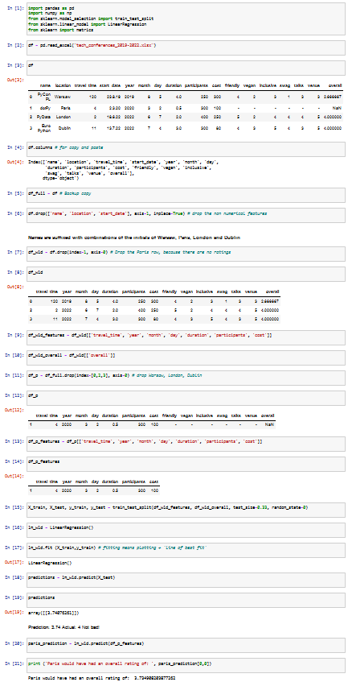
Predicting Paris
Setting up
Remove the Paris row
Removing the non numeric features
Separate the features from the ratings
Coding the model

Slide 13
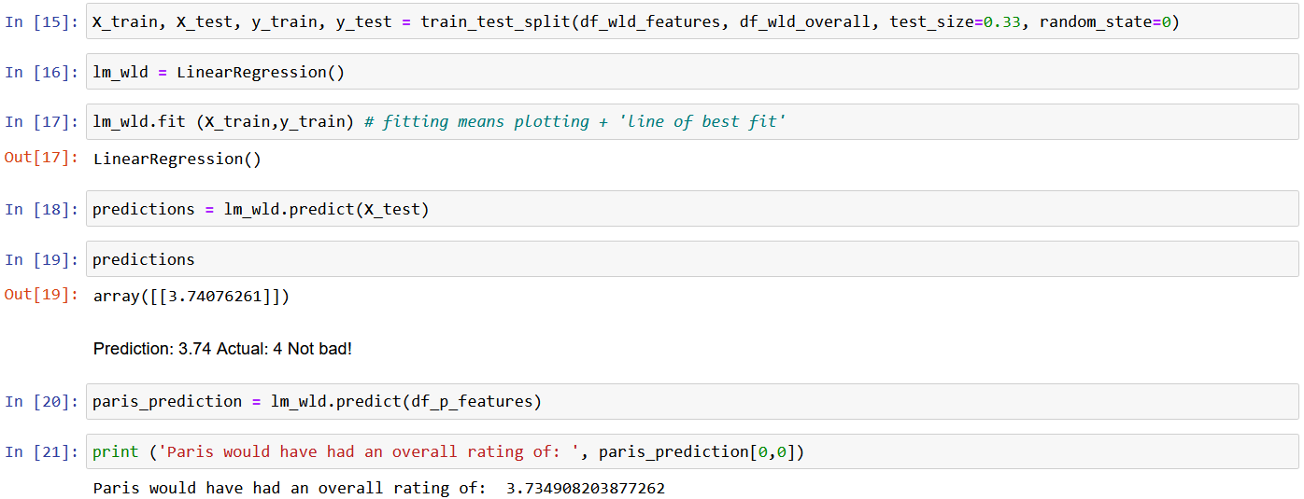
Predicting Paris – Coding the Model

